Slide 1


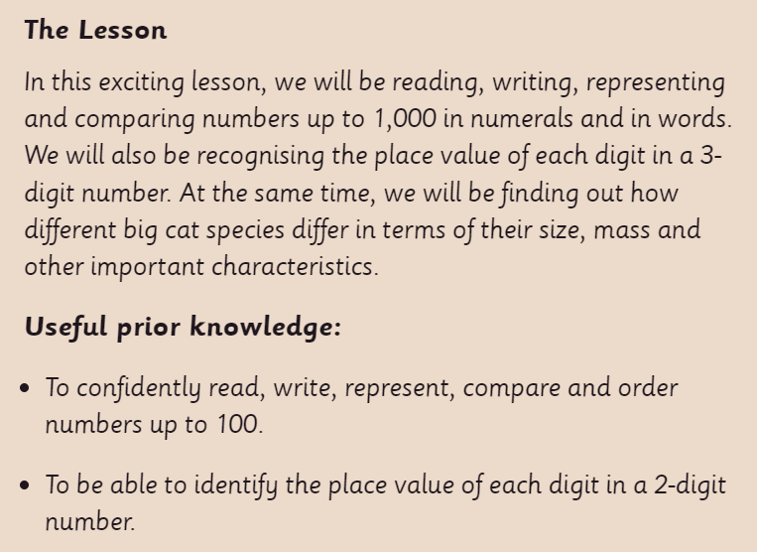
This lesson is best viewed as a slide show, using the PowerPoint annotation pen.

Slide 2

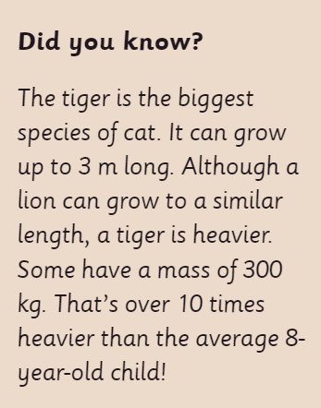

Slide 3
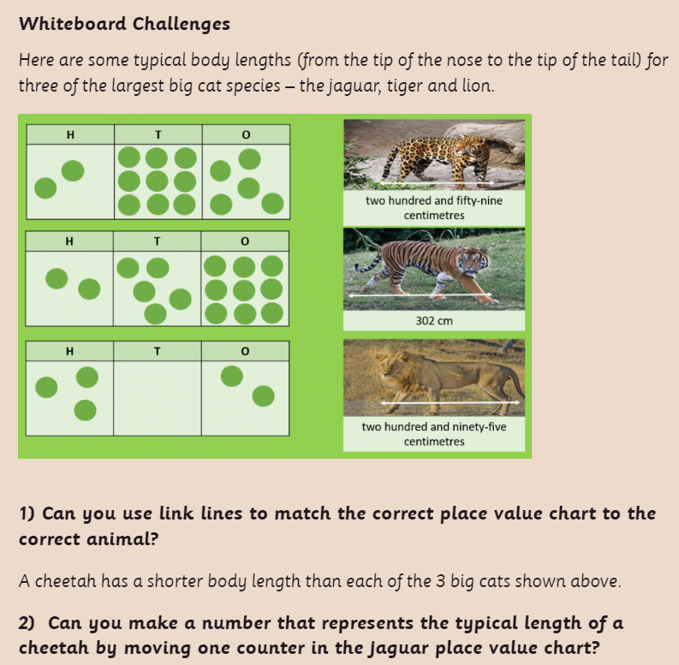

Slide 4
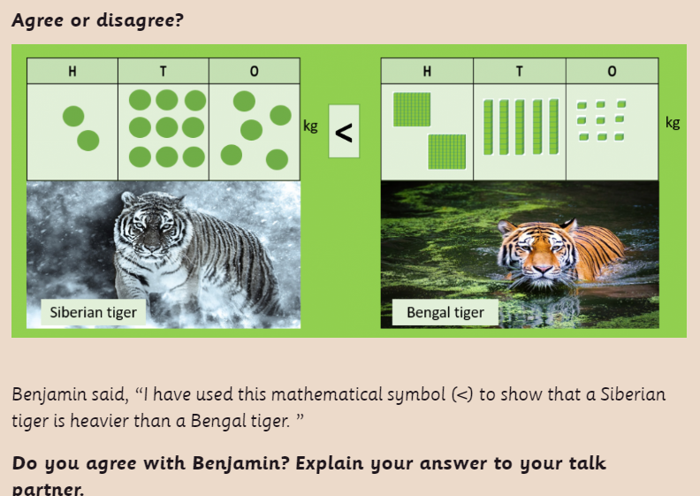

Slide 5


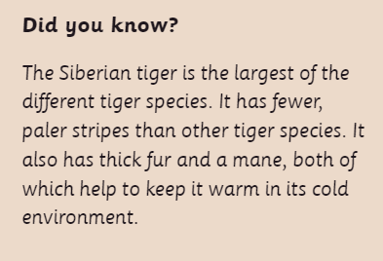

Slide 6
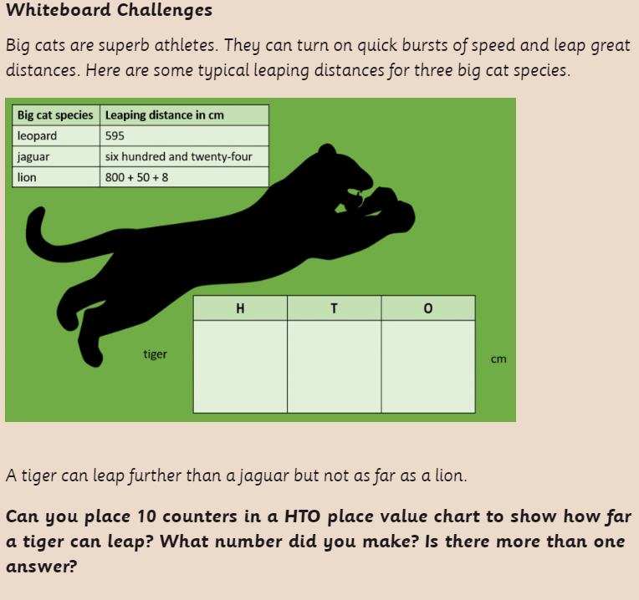

Slide 7
Now have a go at the worksheet.

Slide 8





Plenary: Challenge 3 from the worksheet.

