Slide 1
This lesson is best viewed as a slide show, using the PowerPoint annotation pen.

Slide 2
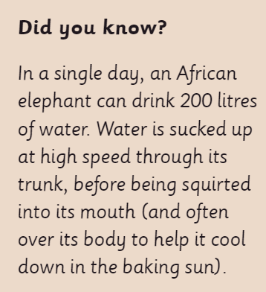

Slide 3
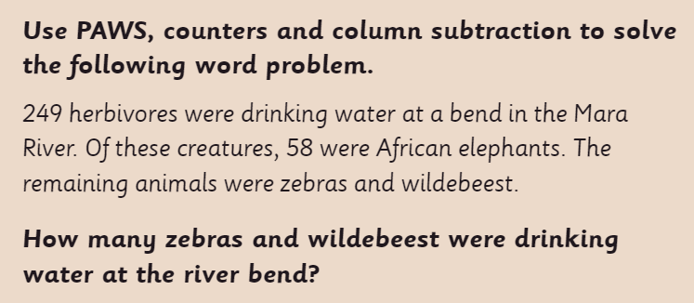
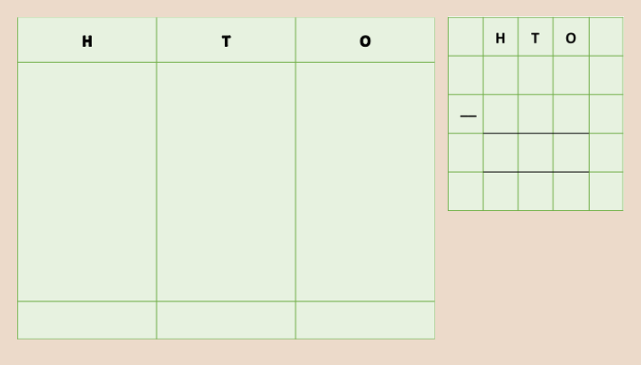
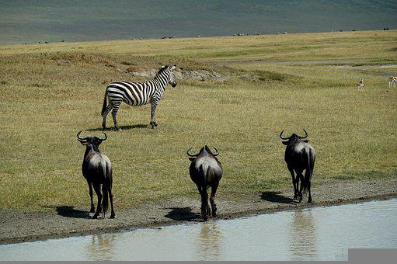

Slide 5
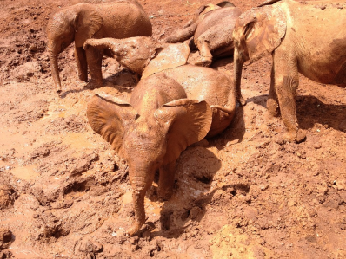

Slide 6
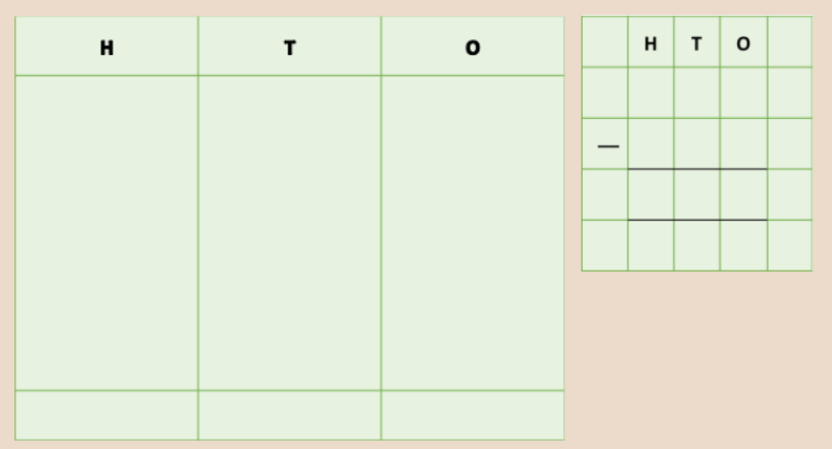

Slide 7
Now have a go at the worksheet.

Slide 8
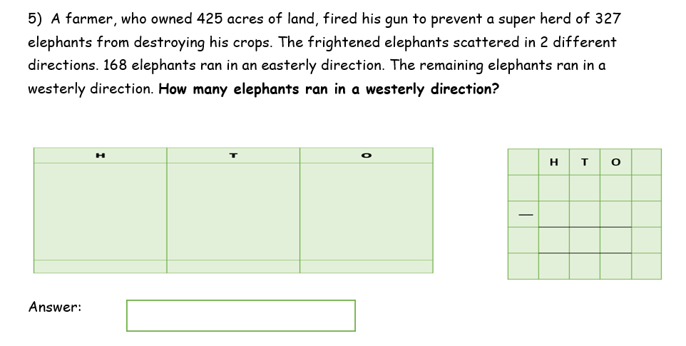
Plenary: Question 5 (Challenge 1) from the worksheet.

