Slide 1

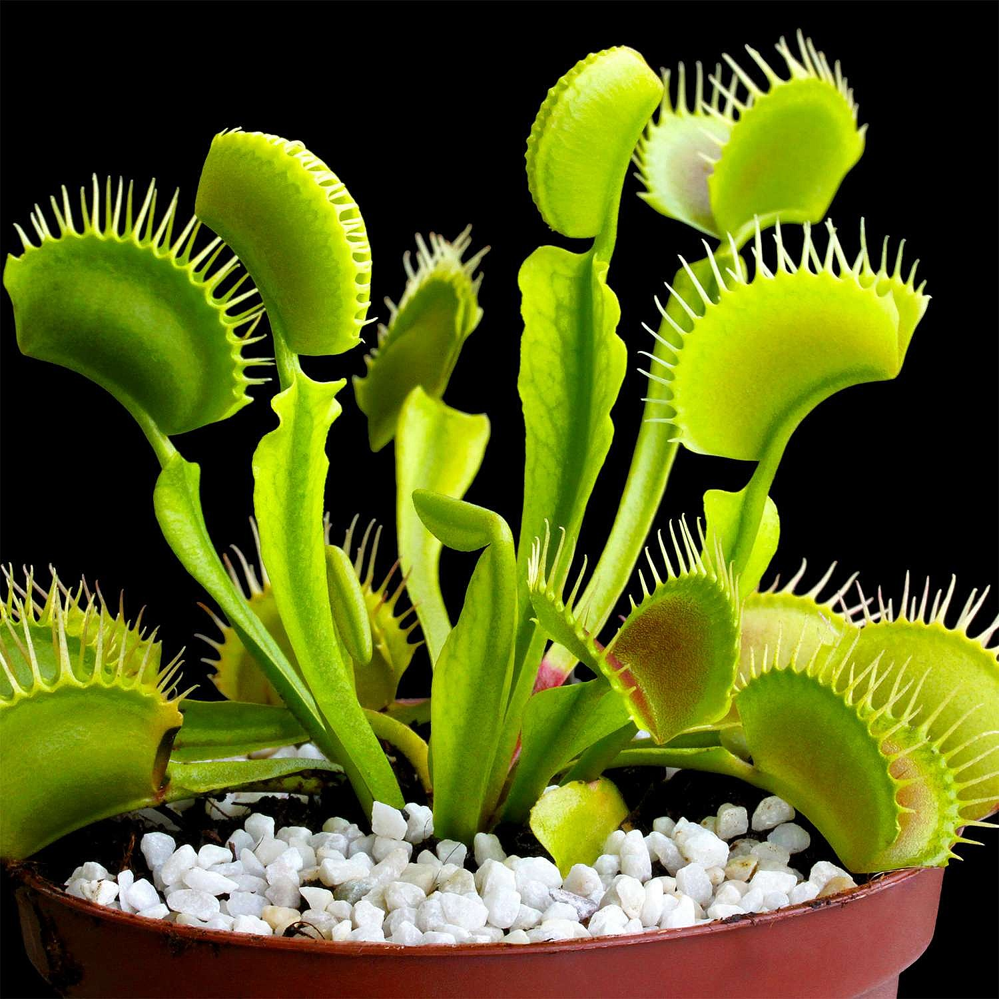
What are they saying to each other?
Link – Clip 1

Slide 2

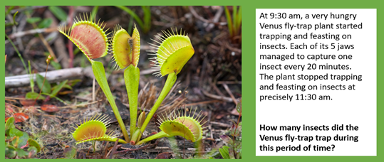
Link – Clip 1

Slide 3
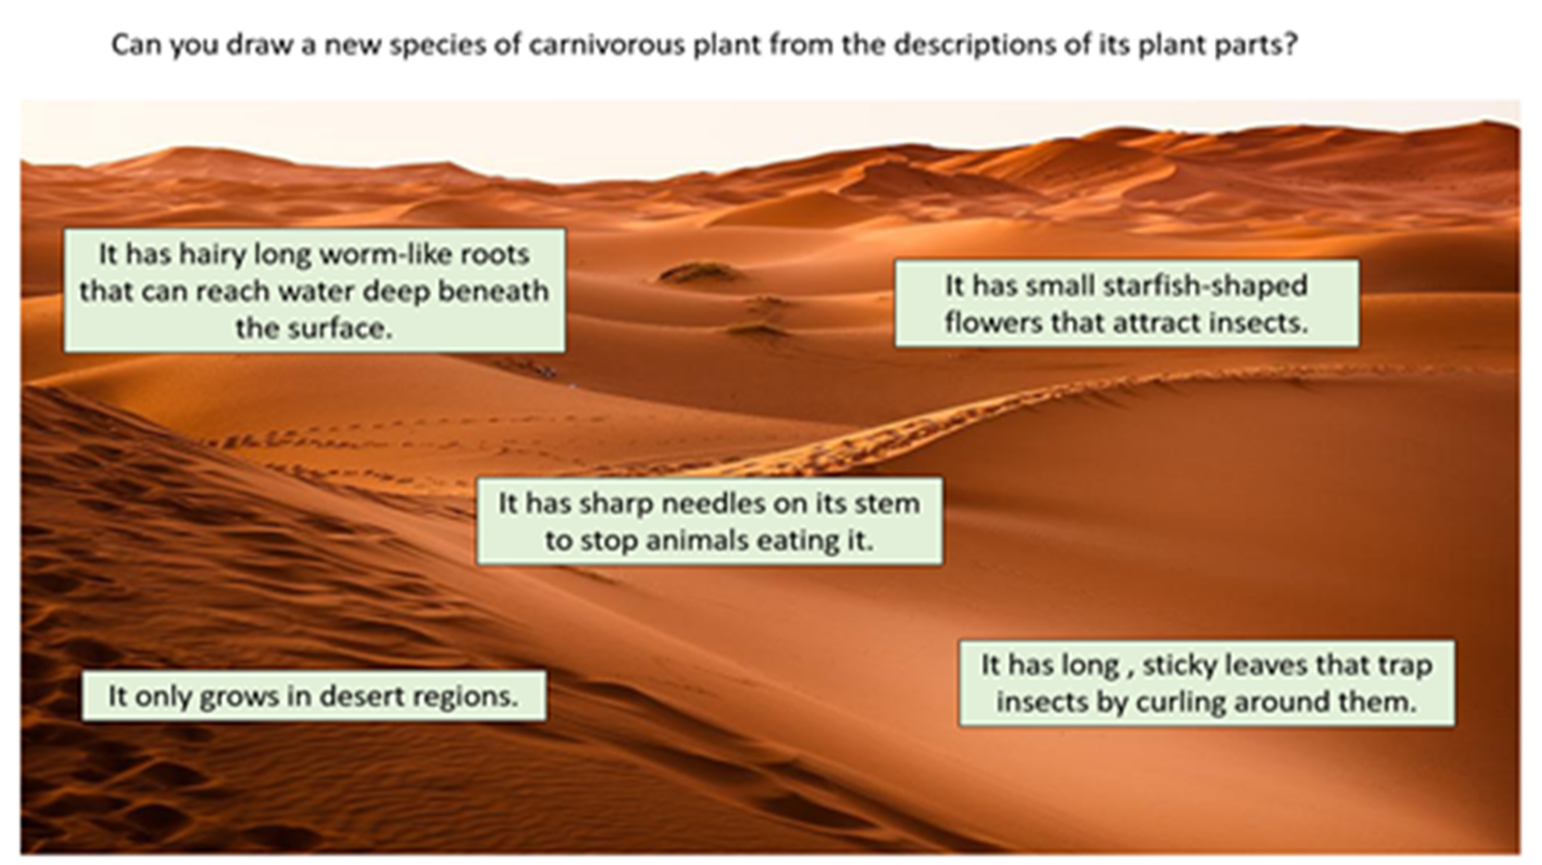
Link – Clip 1

Slide 4
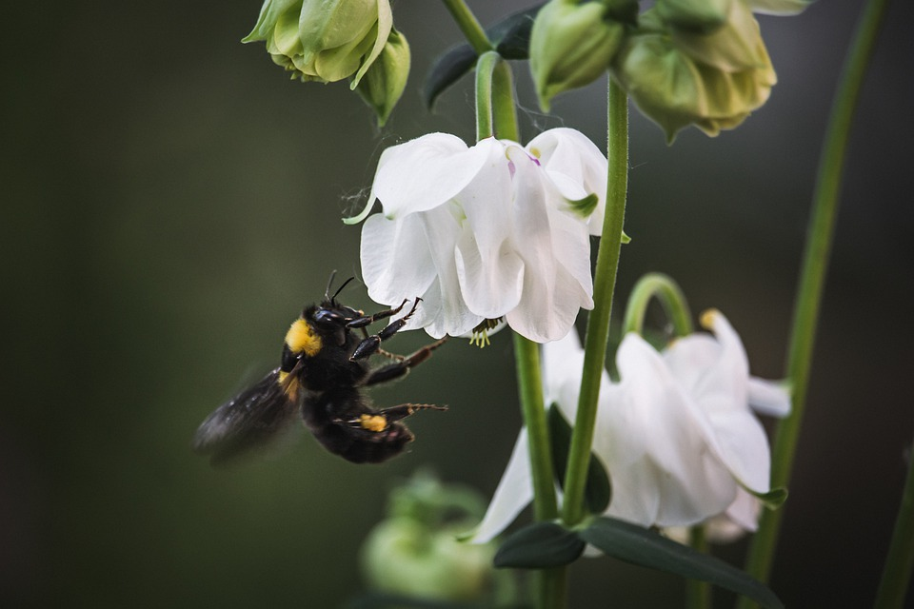
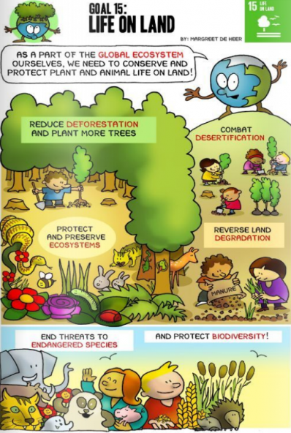
Using your knowledge of plants and the Life on Land poster (SDG 15), see if you can write 5 ‘Top Tips’ that will help protect and promote important plant species in your local area.
Link – Clip 2
Top Tips
Take care not to step on important plant and wildflower species when walking through parks, meadows and woodlands.
2. _______________________________________________
3. _______________________________________________
4. _______________________________________________
5. _______________________________________________

