Slide 1
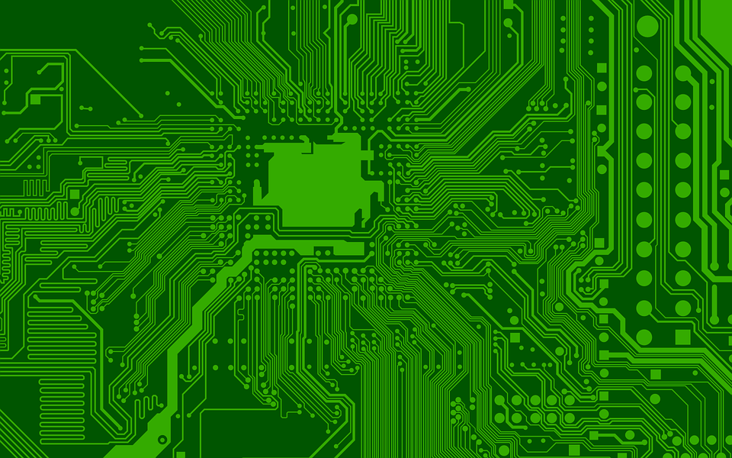
Can you find each of the metals listed below in this word search?
Once you have found the metals, see if you can find out why they are used in electronic devices.

Slide 2
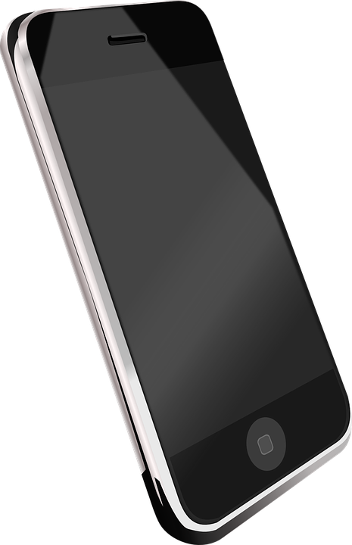
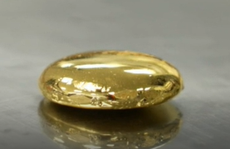
The following amounts of metal can be extracted from 1 million mobile phones:
16,000 kg of copper
350 kg of silver
34 kg of gold
15 kg of palladium
Around how many mobile phones would be needed to extract one metric tonne of gold?
Useful Fact
I metric tonne = 1,000 kg

Slide 3
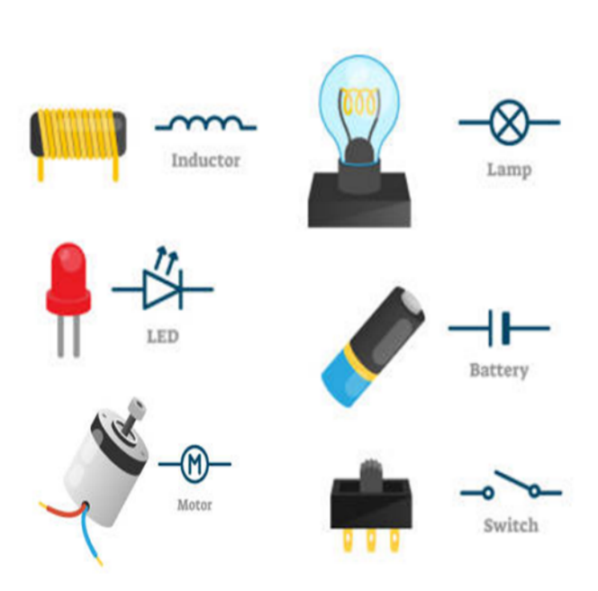
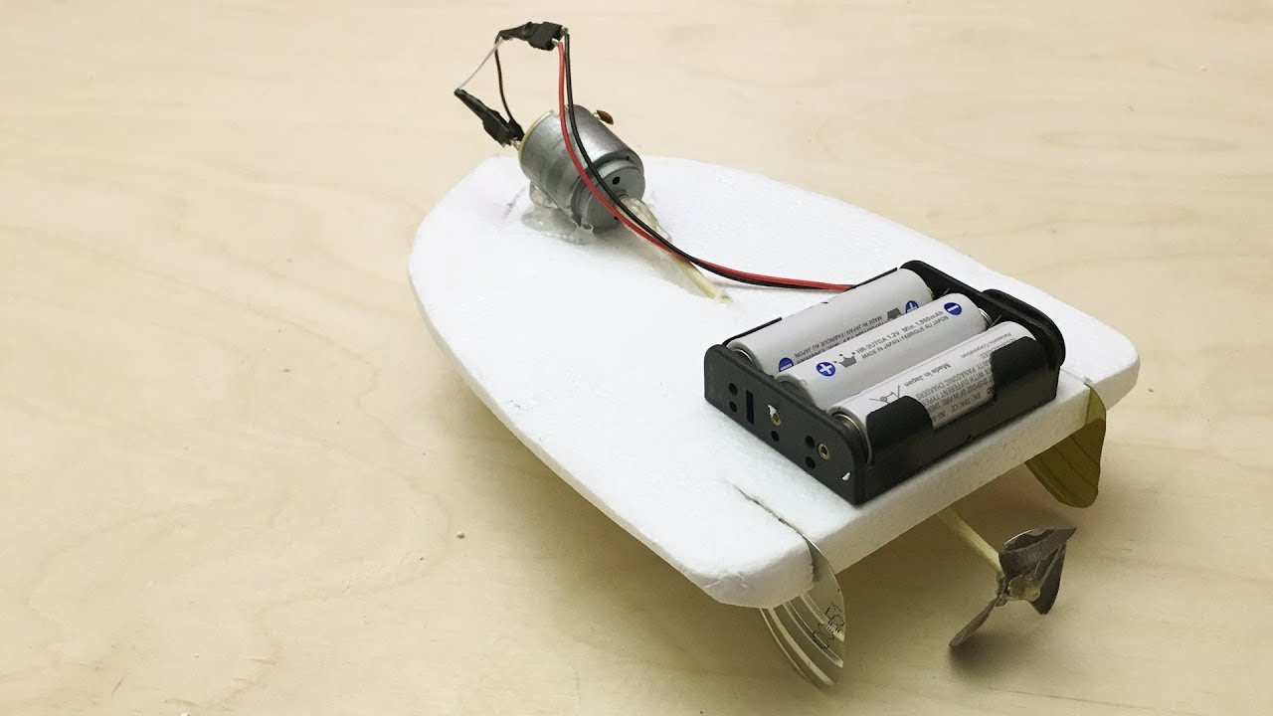
You have decided not to buy a new electronic toy. Instead, you would like to design and make your own electronic toy from some electrical components (see below) and unwanted objects/materials that you have found in your home. What will your design look like?
Electrical components found:
Design: ________________

Slide 4
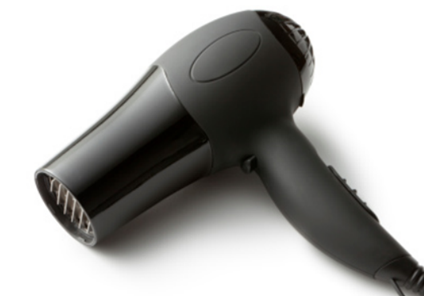
Imagine you can see the inside of a battery-powered hair dryer. Can you draw what you think it would look like using your knowledge of circuits and the description below of how a hair dryer works?
A hair dryer is an electrical device used to dry and style hair. It uses an electric fan (a motor with a propeller attached to it) to blow air across a heating coil (a special piece of coiled wire that heats up when electricity passes through it). The heated air exits the hair dryer and dries wet hair by evaporating the water that is on it.

